Slide 1
Stacks
Presented by s.r.zameer

Slide 2

Stack
A stack is an abstract data type (ADT), commonly used in most programming languages. It is named stack as it behaves like a real-world stack, for example − deck of cards or pile of plates etc.

Slide 3
A real-world stack allows operations at one end only. For example, we can place or remove a card or plate from top of the stack only.
This feature makes it LIFO data structure. LIFO stands for Last-in-first-out. Here, the element which is placed (inserted or added) last, is accessed first. In stack terminology, insertion operation is called PUSH operation and removal operation is called POP operation.

Slide 4
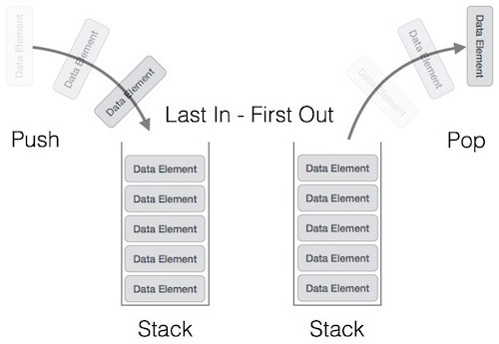
Stack Representation
A stack can be implemented by means of Array, Structure, Pointer and Linked-List. Stack can either be a fixed size one or it may have a sense of dynamic resizing.

Slide 5
Basic Operations
Stack operations may involve initializing the stack, using it and then de-initializing it. Apart from these basic stuffs, a stack is used for the following two primary operations −
push() − pushing (storing) an element on the stack.
pop() − removing (accessing) an element from the stack.
peek() − get the top data element of the stack, without removing it.
isFull() − check if stack is full.
isEmpty() − check if stack is empty.

Slide 6
PUSH Operation
The process of putting a new data element onto stack is known as PUSH Operation.
Algorithm for PUSH operation
Step 1 − Check if stack is full.
Step 2 − If stack is full, produce error and exit.
Step 3 − If stack is not full, increment top to point next empty space.
Step 4 − Add data element to the stack location, where top is pointing.
Step 5 − return success.

Slide 7
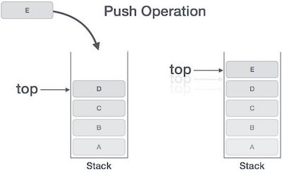

Slide 8
Pop Operation
Accessing the content while removing it from stack, is known as pop operation. In linked-list implementation, pop() actually removes data element and de allocates memory space.
Algorithm for POP operation
Step 1 − Check if stack is empty.
Step 2 − If stack is empty, produce error and exit.
Step 3 − If stack is not empty, access the data element at which top is pointing.
Step 4 − Decrease the value of top by 1.
Step 5 − return success.

Slide 9
